Slide 1
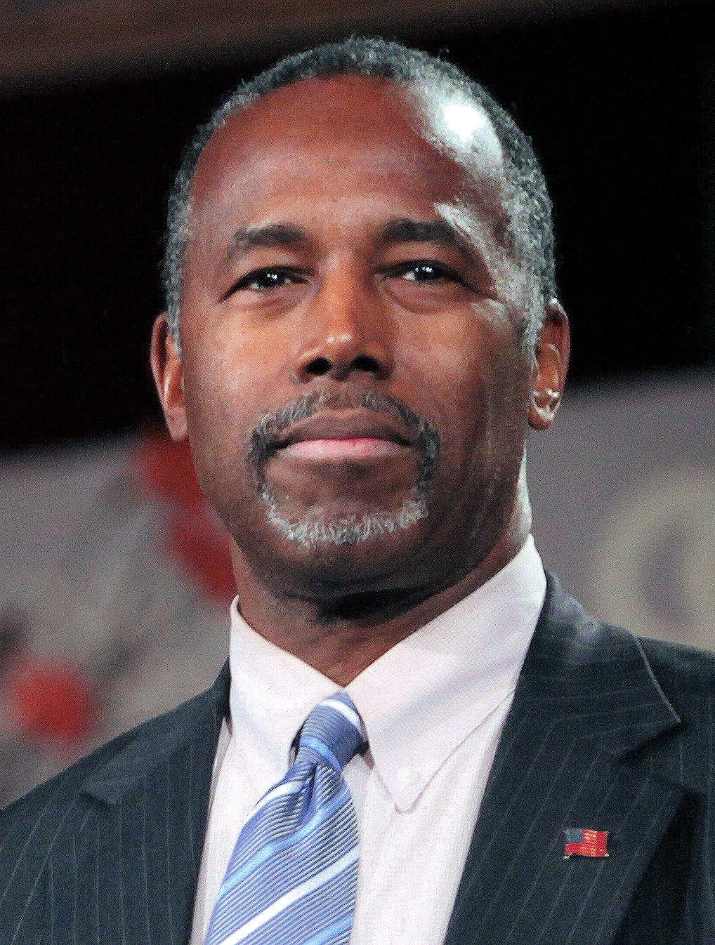
Carson Reading Room Training
Thank you so much for volunteering!

Slide 2
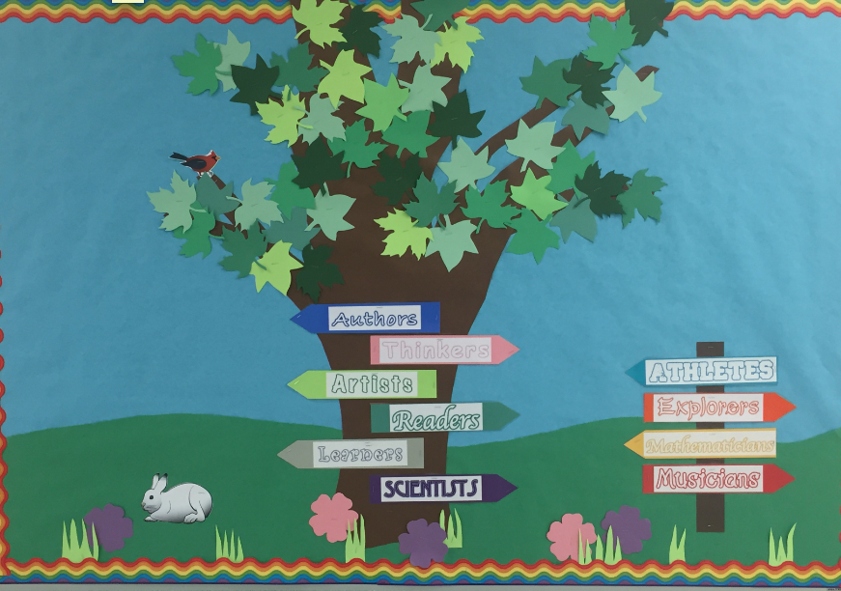
Room 235
A warm, welcoming environment where kids can come relax and enjoy reading for pleasure!

Slide 3
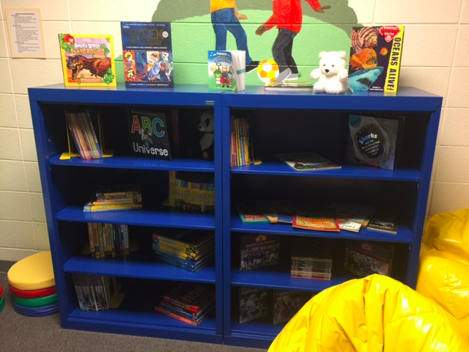
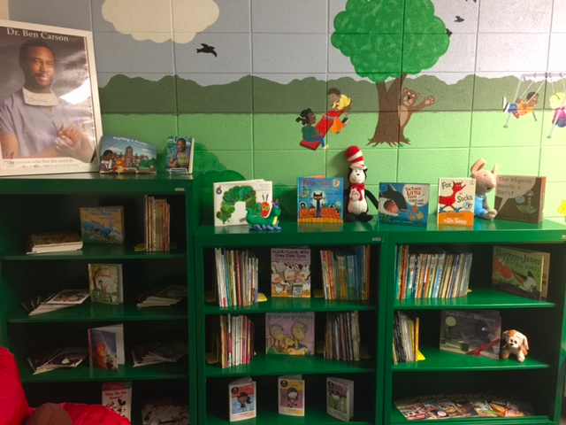
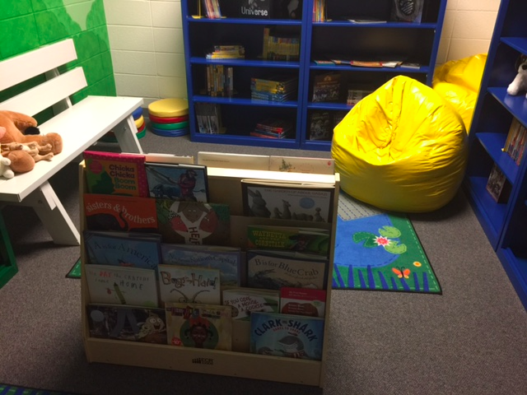

Slide 4
New for 2019/2020!
Each grade will be assigned a specific week three times a year when the entire team will attend the CRR.
Teachers will select the day of that week when their entire class will attend the CRR (during their ELA time.)
Students will be placed into 3-4 groups and attend the room one group at a time during the ELA block.
Parent volunteers will sign up for an hour+ time slot and assist with transitioning the groups to and from the CRR.
GOOD NEWS! This means you will DEFINITELY attend the room with your child at some point in the rotation!
Signups for each grade level will be sent by the ITL 3 times a year.
If individual teachers opt to attend the room more frequently, they will contact parent volunteers directly.

Slide 5
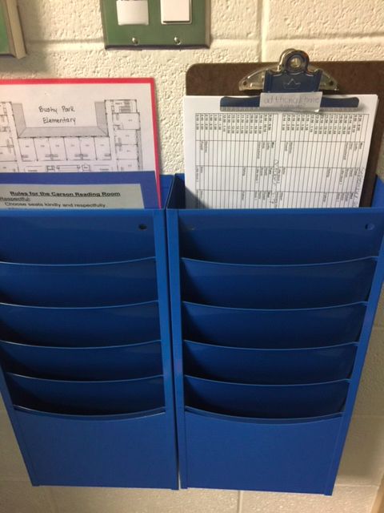
Volunteer Information Station, emergency procedures, and attendance binder

Slide 6
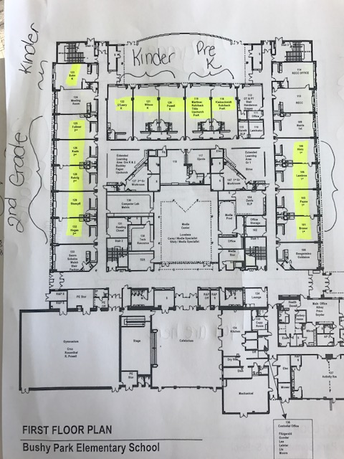
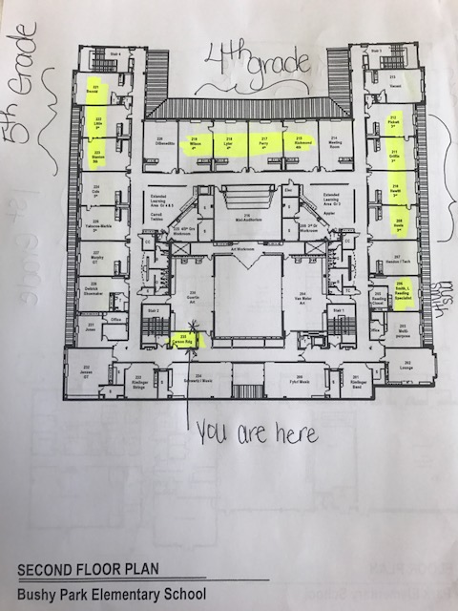

Slide 7
Attendance Sheet (in binder)
Find the teacher’s name in the binder
Please record the date of attendance
Since the entire class will be going throughout the day, there’s no need to take attendance. However, please record the names of students who are absent.
We will schedule a time for absent students to attend.

Slide 8
Volunteer Directions
After singing in the office, go to room 235.
Put on badge and take the binder to the teacher’s class. (See map if needed)
Record the date and the name of any absent students in the binder.
Walk students to the Carson Reading Room and remind them to use a “book marker” when selecting a book so they know where to return it.
Enjoy reading for 20 minutes. Allow 5 minutes to clean up and transition to next group.
Clean up.
Take students back to class and get the next group.
**In the event of a fire drill, follow the emergency exit map to the outside, then find the homeroom teacher
At the end of your shift, please ensure all books are put back in their proper location and that the room is tidy. If you are in need of materials (flashlights, batteries, tissues, etc. please email Sarah Mitchell at bpesptacarsonrr@gmail.com.

Slide 9
What can you do while in the Room?
Help students select books.
Have a student read to you.
Read aloud to a student.
Read with a group of students.
Monitor students as they read independently.
*FLASHLIGHT READING! You may turn out the lights, give students flashlights, and turn on the sound machine/ocean waves projector. The students LOVE this!

Slide 10
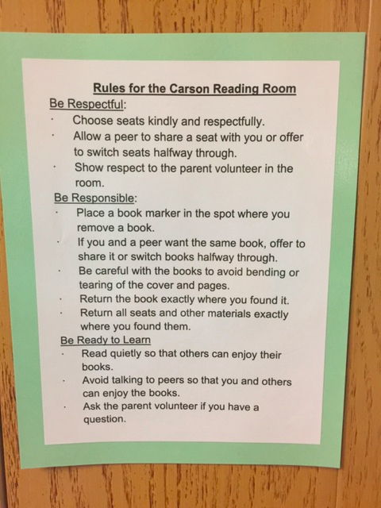
Reminders for Students

Slide 11
If you haven’t already…...
Please complete the HCPSS volunteer training and the BPES volunteer training and turn in your completed certificates to the front office. Both trainings can be found on our school website! Email Sarah Mitchell with questions if you would like further training. bpesptacarsonrr@gmail.com

Slide 12
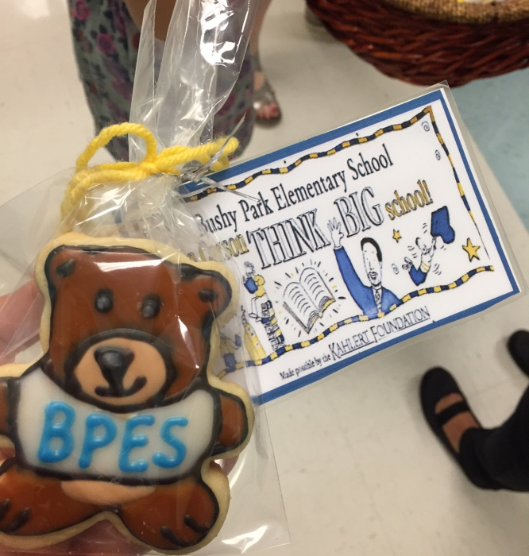
Think Big!
“The book to read is not the one that thinks for you, but the one which makes you think” - Harper Lee
TT
Thank you for helping our students THINK BIG!

