Slide 1
Welcome to
Bushy Park Elementary School
Back to School Night

Slide 2
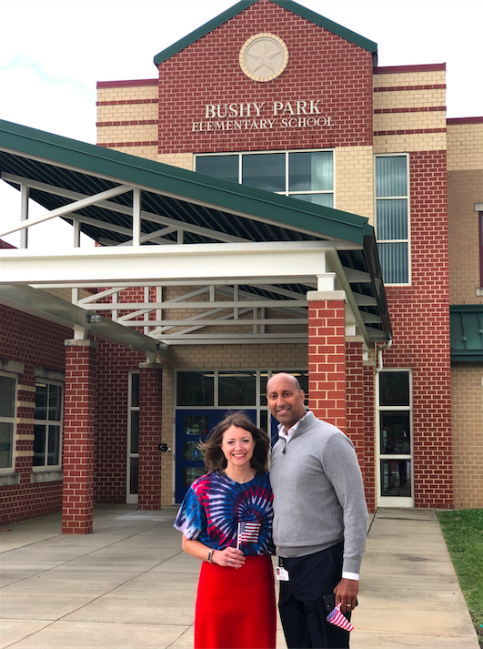
Administrative Team
Mrs. Julia Bialeski, Principal
Mr. (Charles) Keith West, Assistant Principal

Slide 3
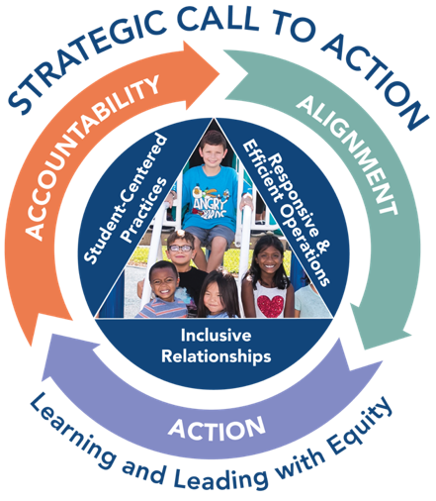
VISION: Every student and staff member embraces diversity and possesses the skills, knowledge and confidence to positively influence the larger community.
MISSION: HCPSS ensures academic success and social-emotional well-being for each student in an inclusive and nurturing environment that closes opportunity gaps.
VALUE
ACHIEVE
EMPOWER
CONNECT
More information: www.hcpss.org/scta
Notes:
Superintendent Michael Martirano has established a bold Strategic Call to Action to guide our school system. “Learning and Leading with Equity” is a strategic plan for building an instructional program to enable every student to reach their greatest potential.
HCPSS is focusing our resources and priorities to make certain that every child graduates from high school and is prepared for the world of work and ready to enter college.
The Strategic Call to Action embodies four commitments to each student, staff member, parent, and community member:
We VALUE every stakeholder, whether student, employee, parent, or community member.
We commit to ACHIEVEMENT by supporting every person in our system - both students and staff - in reaching milestones for personal growth that are appropriate to their goals and strengths.
We CONNECT with students, parents and community members in ways that nurture and restore.
We EMPOWER schools, employees, families, and community members to actively support student achievement and well‐being.

Slide 4
School and System News and Information
Email
Text
School news, HCPSS News,
emergency notices
Urgent / emergency notices only
HCPSS website
School website
bpes.hcpss.org
www.hcpss.org
System-wide news and information resource
School news, calendar, sports and clubs, staff directory; more
Notes:
Parents receive news and announcements from our school and system via the HCPSS News service. Parents are automatically registered for this service. Email messages are delivered to the contact information that you provide in the Family File.
Parents receive via Email:
School newsletters & other communications
Major system-level announcements
HCPSS News weekly newsletter, providing news and upcoming events.
Emergency notifications (school closings/delays).
Text messages: Parents have the option to receive text messages. Texts are sent only for urgent/emergency announcements (school closings and delays, etc.)
New parents are sent a text message to opt-in for text alerts. If you didn’t receive this, visit www.hcpss.org/hcpss-news/ to troubleshoot.
Text alerts will be sent to the mobile phone number identified in Family File.
If you were opted-in to receive text messages last year, and your phone number has not changed, you do not need to opt-in again.
Our school website is a one-stop destination where you can quickly find:
School calendar, announcements and news
Student activities, sports, clubs
Services including school meals
Staff directory and email links
Quick Links to HCPSS Connect, system website, and other resources for students and parents

Slide 5
Social Media
Bushy Park ES Twitter: @hcpss_bpes
HCPSS Facebook: www.Facebook.com/HoCoSchools
HCPSS Twitter: www.Twitter.com/HCPSS
HCPSS Instagram: instagram.com/hocoschools
HCPSS Flickr: flickr.com/photos/hcpss
Superintendent Twitter: https://twitter.com/mjmsuper
Notes:
Link to our social media sites:
Get up-to-the-minute updates, news, student and school happenings, and announcements
Interact with the school and system

Slide 6
Weekly System Emails
School system news and announcements
Upcoming events
Opportunities to share input on HCPSS policies and decisions
Delivered each Wednesday
Notes:
Watch your inbox for HCPSS News each Wednesday throughout the school year.
The HCPSS News weekly email is your source for announcements of
Upcoming school system programs and events
Public Hearings and other opportunities to share input and feedback
Opportunities to participate on school system committees
Boundary Review updates, and other important information.
All parents are automatically subscribed to HCPSS News.

Slide 7
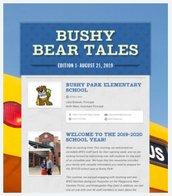
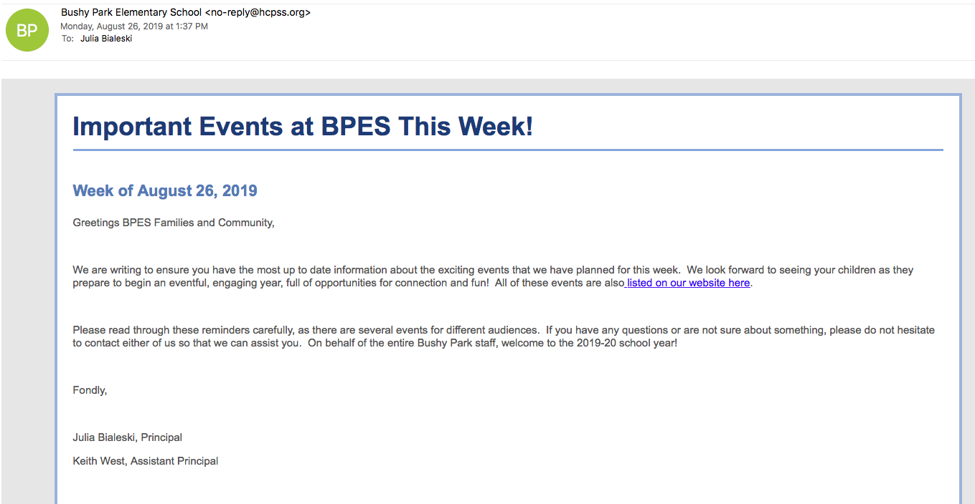
Bushy Park Communication
Bushy Bear Tales
SchoolMessenger
Notes:
The Bushy Bear Tales is our bi-weekly newsletter, which will be sent out every other Wednesday. In addition, we will use SchoolMessenger as a tool to communicate timely information to our families. Please read our emails to ensure you are up to date on what is happening at BPES!

Slide 8
HCPSS Mobile App
Free download on App Store:
iPhone
iPad
Android
Notes:
The HCPSS Mobile App is available free to download for iphones, iPad, and Android devices in the app stores (search for “HCPSS”).
The app makes it quick and easy to find the information you need, when you need it. It provides:
Messages and calendar dates from all of the schools that your children attend, as well as school district information.
School menus
Simplified access to information and quick links

Slide 9
School Closings/Delays
www.HCPSS.org
@hcpss
HCPSS News
HoCoSchools
HCPSS TV
Hotline
Verizon 42
Comcast 72
410-313-6666
Notes:
School Delays and Closings (usually weather-related) are communicated through several information sources:
HCPSS homepage: www.hcpss.org - this is the first and most complete source of information
HCPSS News emails and texts (as described on earlier slide)
Social media: Twitter (@hcpss) & Facebook (HoCoSchools)
HCPSS TV – channel 42 (Verizon) and 72 (Comcast)
HCPSS Information Hotline recording – 410-313-6666

Slide 10
Mental Health and Student Supports
School Counselor: Beth Bengermino elizabeth_bengermino@hcpss.org
School Psychologist: Dr. Grace Jones grace_jones@hcpss.org
Pupil Personnel Worker: Neil Gwinn neil_gwinn@hcpss.org
More information: www.hcpss.org/supports/mental-health-wellness
Notes:
The mental health and well-being of our students is very important to us. Staff in the building are here to support students and families. These staff work with all students to develop their unique strengths and abilities.
Each of these staff members wants to work with parents to best support your child. Please do not hesitate to contact them with questions or concerns.
The “Mental Health and Wellness” page on the HCPSS website provides many valuable resources for all families. Search for “mental health” at www.hcpss.org.

Slide 11
Synergy Student
Information System
Canvas
Learning System
Family File
www.hcpss.org/connect
Notes:
HCPSS Connect is the one-stop portal to access Synergy, Canvas, and the Family File.
The Synergy Student Information is your source for official student records & grades.
The Canvas Learning System gives teachers, parents, and students tools to communicate, collaborate, and connect.
Both systems are extremely easy to learn and to use.
Benefits of HCPSS Connect for Parents, Students & Teachers:
Improved communication and collaboration
All schools and grades use the same digital platform
Single sign-on - 1 user/pass for HCPSS Connect
Anytime/anywhere access
Find full details and instructions online at www.hcpss.org/connect

Slide 12
Update Student Information
Parent contact information
Medical data and contacts
After-school transportation
Data privacy preferences
Athletic participation forms
www.hcpss.org/connect
Notes:
The Family File on HCPSS Connect provides important information about your student. All information is confidential.
It is important that parents update the Family File each year with current data about your student including:
Parent emails and phone numbers
Student medical contact data
After-school transportation options
Data privacy options
Log into HCPSS Connect and click the My Account tab. Save your changes by clicking the Update Account button.
Parents can make changes in the Family File at any time during the year.
Parents without online access can provide this information through a paper “Emergency Procedure and Confidential Student Information” form. Contact the school office for a copy of this form.
Athletic participation forms can be completed online in Synergy.

Slide 13
HCPSS Connect: How to Get Help
Login Assistance:
Contact the school office
Guides and Resources:
www.hcpss.org/connect
Notes:
Parents will continue to use the same log in credentials as in prior years.
Parents of students new to HCPSS will receive their login information via US Mail.
For help with your login or password: call the School Office
For help in using Canvas, Synergy, or the Family File, see the many guides and resources on the HCPSS Connect homepage (www.hcpss.org/connect), or contact the school office.

Slide 14
Canvas: What to Expect
Course Homepage:
Overview
Student privacy information
Resources
Calendar dates/events
Announcements
Student skill building (grade appropriate)
CANVAS
Have Canvas Questions? Click the Orientation box on the Canvas homepage to access Parent Guides
Notes:
Canvas is HCPSS’s Learning Management System. In elementary school, teachers primarily use Canvas to share general course information and resources, send out announcements, and share calendar events. Your child’s classroom teacher may publish their individual ELA or Math courses, or they may work as a grade-level team and share information from the grade-level page. In upper-elementary grades, your child’s teacher may use more of Canvas’s other tools, such as online discussion boards, quizzes, and digital assignment submissions.
CANVAS EXPECTATIONS for teachers:
Each Canvas course will have the following:
Course homepage
Overview - Information about the course and teacher or about the grade-level team
Student privacy information - Information on homepage or grade level page regarding teachers’ use of recording devices and digital tools for school-related activities
Resources - Links to instructional tools or resources for families
Calendar dates - Share class/grade specific dates and events with families and students using the Canvas calendar
Announcements – Teachers will communicate timely information with students and families using announcements either through the teacher course or grade level course. By default, announcements will be sent to parent’s primary email in Family File
In addition, teachers will help students develop their Canvas and online learning skills with grade-appropriate activities.
Parents can learn more about how to use Canvas by going to the Canvas Orientation course (link at the top of the Canvas homepage). There, they can learn how to navigate Canvas and change their notification preferences.

Slide 15
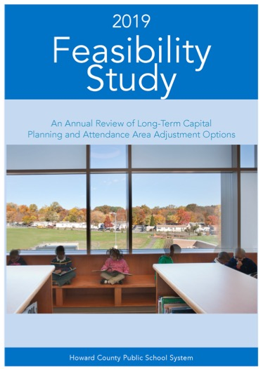
Boundary Review Process
Potentially impacting any HCPSS school
2020-2021 school year
Upcoming public input opportunities:
Board public hearing: Thursday, September 26 at 7pm (pre-registration required)
Full information: www.hcpss.org/school-planning/boundary-review
Notes:
The Howard County Public School System is undergoing a countywide boundary review process. The process could ultimately impact any of the 74 comprehensive schools in our system.
Current and complete Information is provided on the website: https://www.hcpss.org/school-planning/boundary-review/
The Board will make its final decision on Nov. 21, 2019. Any changes, if approved, would take effect no sooner than the 2020-21 school year.
Updates are provided in the HCPSS News weekly emails and through social media.

Slide 16
Elementary Report Card: Changes for 2019-20
Learning Behaviors
Student demonstrates…
Interpersonal skills
Responsibility
Perseverance
Collaboration
Initiative
Reporting
For each learning behavior…
1 - Meets expectations
2 - Making progress towards expectations
3 - Limited / no progress towards expectation
Notes:
Beginning this year, changes to Learning Behaviors will be made to your child’s report card to provide greater insights to parents/guardians.
Beginning this school year, you will notice a minor modification to the Learning Behaviors section of your child’s report card. Previously, the report card included 12 learning behaviors. On the 2019-2020 report card, closely related learning behaviors are combined into five major categories, to support parents and teachers in identifying the areas of focus. These will identify how the student is demonstrating:
Interpersonal Skills
Responsibility
Perseverance
Collaboration
Initiative
Teachers will report student performance on each learning behavior your child demonstrates in their class, based on developmentally and age-appropriate expectations and standards:
1 - Meets Expectations
2 - Making Progress Towards Expectations
3 - Limited / No Progress Towards Expectations
The revised reporting aligns with changes recently made to HCPSS Policy 8010: Grading and Reporting. On the HCPSS website at www.hcpss.org, you can find the indicators that identify the specific behaviors, actions, and expectations that align with each learning behavior.

Slide 17
MCAP Assessments - Spring
Mathematics and English/Language Arts
Grades 3-5
Notes:
MCAP (Maryland Comprehensive Assessment Program) English Language Arts and Math is the name for the standardized reading, writing and mathematics assessments implemented in all Maryland schools. MCAP ELA and Math assessments are directly aligned to the MD College and Career Ready standards.
MCAP ELA and Math purposes:
Indicates how closely students, beginning in Grade 3, are on track to graduate college- and career-ready.
Gives teachers insights to guide instruction.
Provides data comparable across districts and states.
Scoring:
The MCAP ELA and Math assessments are scored on a 5 point scale: 1-Did not yet meet expectations, 2-Partially met expectations, 3-Approached expectations, 4-Met Expectations, and 5-Exceeded expectations:
In grades 3-8, ratings of 4-5 indicate students are academically well-prepared to engage successfully in further study.
In high school courses, a 4-5 indicates students are on track to graduate prepared for colleges and careers. In future years, 4-5 will be used by in-state community colleges for placement in credit bearing courses.
Students will take MCAP ELA and Math assessments in the spring. Students will hand-carry the results home in the first few weeks of the following school year.

Slide 18
Measures of Academic Progress (MAP)
Grades 1-2: fall, winter and spring
Grades 3-5: fall and winter
Mathematics and reading
Computer-adaptive
Year-to-year growth
Notes:
MAP (or Measures of Academic Progress) is an online test used in Grades 1-8.
MAP allows us to assess where a student is performing, and how they’ve grown in achievement. All HCPSS Elementary and Middle schools participate in MAP.
This school year, Grades 1-2 will take MAP in the fall and spring. Grades 3-5 will take MAP in fall and winter.
MAP gives timely feedback on student progress that teachers use to adjust instruction effectively.
MAP provides many advantages:
Assesses proficiency in Math and Language usage in addition to Reading.
Computer-adaptive – i.e. the questions adapt in real-time to the student’s proficiency level. This appeals to students, because it isn’t a typical “mastery” test.
Provides quick, actionable feedback to teachers.
Directly aligned to Common Core standards.
Provides information on a student’s year to year growth.
Takes less time than the previous HCPSS quarterly assessments.
Students hand-carry results home a few weeks after the testing window ends.

Slide 19
CogAT (Cognitive Abilities Test)
Grades 3 & 5
Verbal, quantitative, and learned reasoning abilities
Informs GT placement decisions
Notes:
CogAT (Cognitive Abilities Test) is used in grades 3 and 5 to make student placement decisions for Gifted & Talented (G/T) programs. CogAT measures students’ verbal, quantitative and nonverbal reasoning abilities: the three areas most closely related to success in school.
We know that students who participate in our Gifted and Talented program are well-prepared for the rigorous opportunities that come later in high school and college. Our goal is to widen access to enriching learning opportunities for all students. CogAT is only one of many pieces of data that are looked by a school based committee to make placement decisions.
The CoGAT provides valuable data that is not measured by other tests. This data is used to identify students who would benefit from GT coursework, and by teachers to tailor instruction to meet student needs:
CogAT measures learned reasoning abilities. These include abilities developed through both in-school or out-of-school experiences. Each of the three subtest areas make use of multiple test formats. This increases both the fairness and the validity of the scores.
The verbal portion of the test measures flexibility, fluency, and adaptability in reasoning and solving verbal problems. These play an important role in reading comprehension, critical thinking, writing, and virtually all verbal learning tasks.
The quantitative portion measures quantitative reasoning skills that are significantly related to problem solving in mathematics and other disciplines.
The nonverbal portion measures a student’s ability to invent and implement strategies for solving novel problems.
Results are mailed home with placement recommendations in the spring.

Slide 20
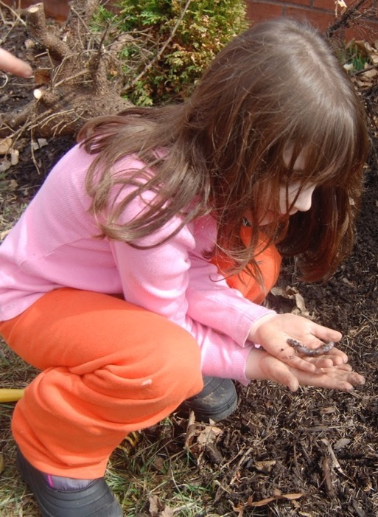
Maryland Integrated Science Assessment (MISA)
Grade 5
Aligned to HCPSS science curriculum and Next Generation Science Standards (NGSS)
More information: Search for “NGSS” on www.hcpss.org
Notes:
MISA (Maryland Integrated Science Assessment) is the standardized science assessment, developed and implemented by the Maryland State Department of Education (MSDE).
MISA is an online test and, like our science curriculum, is aligned to the Next Generation Science Standards (NGSS). MISA covers all science disciplines: Earth/Space science, Life Science, Physical Science, and Engineering.
The Next Generation Science Standards (NGSS) are critical for all students, beginning as early as prekindergarten. The NGSS provide consistency in science instruction while connecting tightly with mathematics and English Language Arts.
Students cannot simply read about science in order to learn science – they must do science. In an NGSS science classroom, students operate as student scientists under the skillful facilitation of their teacher. Participation in science enables students to apply their mathematics learning, and to read and communicate using evidence.
Our goal is to ensure students are scientifically literate, rather than teaching them to pass a standardized test. Thus, the MISA test is not aligned to any unit of study or specific content to memorize.
For elementary students, MISA will take place in 5th grade. Students will take MISA again in 8th grade, and then in High School.
You can find more information about the HCPSS science curriculum and the Next Generation Science Standards on our website: search for “NGSS” on www.hcpss.org.

Slide 21
Interactive School Menus
Food descriptions
Nutrition and allergens
Carb counts
Pre-payment links
Menus
Breakfast and lunch
http://hcpss.nutrislice.com
free iPhone or IOS app
HCPSS Mobile App
Notes:
HCPSS offers online school menus through a website and mobile app by Nutrislice.
The interactive menus provide access to up-to-the-minute content anytime, anywhere.
The innovative school menu site features nutrition and allergen information for all Howard County school meal items, both breakfast and lunch, and includes:
Carb counts
Allergen filters
Food descriptions and photos
Menu item rating system
Links to MySchoolBucks pre-payment options
Monthly menu email subscription sign-up
And more
Menus are available in several languages: English, Spanish, Korean, Chinese, and French.
Options for using the interactive menus:
Online: hcpss.nutrislice.com
Download the free app, “School Lunch by Nutrislice,” in the Google Play or App stores.
Select the “Menus” icon on the HCPSS mobile app
Pick up the “Food and Nutrition Services” handout for more information about school meals, our Point of Sale system, and more.

Slide 22
Free and Reduced-Price Meals (FARMs)
Qualifying families can receive free or reduced-cost:
School meals
Health insurance
HCC tuition
SAT, ACT and AP exam fees
Camps, sports, child care
Many other benefits
Learn more and apply: www.hcpss.org/farms
Notes:
HCPSS participates in the National School Lunch and Breakfast Programs.
The Free and Reduced Price Meals program (FARMs) helps many families save money in many ways including free or lower prices for:
School breakfast and lunch
HCC tuition
SAT, ACT and AP exam fees
Camps, sports and child care
And many other programs and services
FARMs enrollment is confidential. Students whose families are in the program are not identified in any way.
Qualification is based on family size and income.
Go to www.hcpss.org/farms for more information, to see if you qualify, and to apply.
Pick up the “Food and Nutrition Services” handout for more information about FARMs, school meals, our Point of Sale system, and more.

Slide 23
Student Technology Use in School
Students may use their personal technology:
When permitted by a teacher or administrator
Before and after school
Devices must remain off and in backpack during school hours
Students are never required or expected to bring a personal device to school
Visit HCPSS.org for student & parent expectations
Notes:
HCPSS permits students to bring personal technology devices to school for instructional or personal use, under the discretion of school administrators and teachers.
Students will never be required or expected to bring a personal device to school. When an instructional activity is planned that needs access to individual technology, devices will be provided for use by students who do not have their own technology.
The rules for [this school] regarding student use of personal technology use during class transitions, lunch and special events are __[specific rules to be completed by principal]__.
Students, with parent/guardian permission, assume full responsibility for their devices including safety, security and maintenance. You can find details on student and parent expectations for personal technology on the HCPSS website: www.hcpss.org.

Slide 24
What Your Child Will Learn Guides
On Canvas via HCPSS Connect
Curriculum content overview for each
Grade (PreK – 5)
Subject area
www.hcpss.org/connect
Notes:
What Your Child Will Learn guides provide an overview of the instructional program for your child’s grade, as well as student goals and expectations. The guides include information to help parents monitor and support their child’s progress during the school year.
Individual guides are provided for each grade level. The guide identifies the content covered in each curriculum area, categorized by subject, e.g., Language Arts, Science, etc.
Find the guides online in Canvas. (The guides are available online only; print versions are no longer distributed.)
The guides provide general information about curriculum content. Specific student programs may differ, depending on instructional needs.

Slide 25
Leading with Kindness
Notes:
Welcome from the PTA
Recognize Eileen Dietz:
Steward of the organization
President for three years
Parent Volunteers, PTA Leadership

Slide 26
1
2
Membership
Bear Dash
Bushy
Tonight
October
Notes:
Membership. We need you to support the PTA. With your membership ($20) and any additional donations you’d like to make at this time.
We understand that many of your have complex schedules and may not be able to volunteer. If you can give more, please do.
Bushy Bear Dash. I need you to generously support the Bushy Bear Dash fundraiser. This is our biggest fundraiser of the year. We spend about $120 per child each year. BUT, we can only do that if we meet our fundraising goal.
Before you leave tonight, please stop by our the PTA table.

Slide 27
Programs
Afterschool Activities
Beary Grateful Fund
Classroom Gift Fund
Council Delegate
Cultural Arts
Diversity, Equity and Inclusion
Girls On The Run
Grounds Beautification
Hero Boys
Hospitality
Membership
Reflections
Retail Rewards
Room & Team Parents
Spirit Wear
School Supplies Kits
Teacher Supply Closet
Walking Wednesday
Ice Cream Social
International Night
Junior Achievement
Robotics Night
Science Fair
Spring Fling
Sweetheart Dance
Events
5th Grade Picnic
Bingo Night
Book Fairs
Bushy Bear Dash
Bushy Blooms
Fall Fest
Assets
“Green Notes”
Directory
Facebook
Newsletters
Website
Yearbook

Slide 28
September 9th
7-8pm
October Family Craft Night
November Family Fit Night
December Winter Potluck & Musical Guests
January Storytime & Snacks
February Valentine Workshop
March Talent Show
April Math Game Night
May Adult Softball Game
June Summer Potluck & Musical Guests
Budget Approval
Committee Meetings
Volunteer Opportunities
Q&A
Childcare Provided

Slide 29
Team Presentations
1st grade - Media Center
2nd grade - Cafeteria
GT - Mr. Van Meter’s art room (upstairs)
3rd grade - Media Center
4th grade - Mini auditorium (upstairs)
5th grade - Cafeteria

