Slide 1
First Grade
2019-20
Bushy Park Elementary

Slide 4
Schedule
9:10-9:20 Opening/Morning Work
9:20-9:25 Announcements
9:25-9:40 Community Circles
9:30-11:30 ELA
11:30-12:00 Recess
12:00-12:30 Lunch
12:30-12:45 Interactive Read Aloud
12:45-2:00 Math
2:00-2:35 Content (Health/Science/Social Studies)
2:35-2:40 Stack & Pack
2:40-3:40 Related Arts (PE, Music, Technology, Art,
Media)
3:45 Announcements
3:50 Dismissal

Slide 5
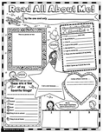
ELA
Reading Writing
Star of the Week Independent Activities
Notes:
Share the aspects of ELA block.

Slide 6
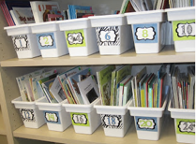
Book Boxes
Each student has their own book box to
use during the ElA block
WE COULD USE YOUR HELP…
Please send in 3-4 books each month, with your child, so they will have some familiar books to read in their book boxes.
We could use donations of new or gently used books for our classroom libraries.
Scholastic book orders help us add to the classroom library.
Notes:
Each student has a book box where they keep books to read throughout the ELA block. Having familiar books is important throughout the year. We will send periodic reminders to have you send in new books. Please label the books with your name.
Scholastic book orders help us get free books to add to our classroom library.

Slide 7
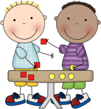
Math
Flexible Grouping
Math Routines
Instructional groups
Vocabulary
Hands-on activities/games
Problem solving
Place value
Addition/Subtraction
Fact Fluency
Time
Measurement
Shapes/Attributes
Notes:
Share general information- FLEXIBLE grouping
Groups
Hands on activities
Importance of math facts

Slide 8
Science
Animal & Plant Structures
Patterns in Space
Light
Sound
Notes:
Here are the units that we will cover this year in science

Slide 9
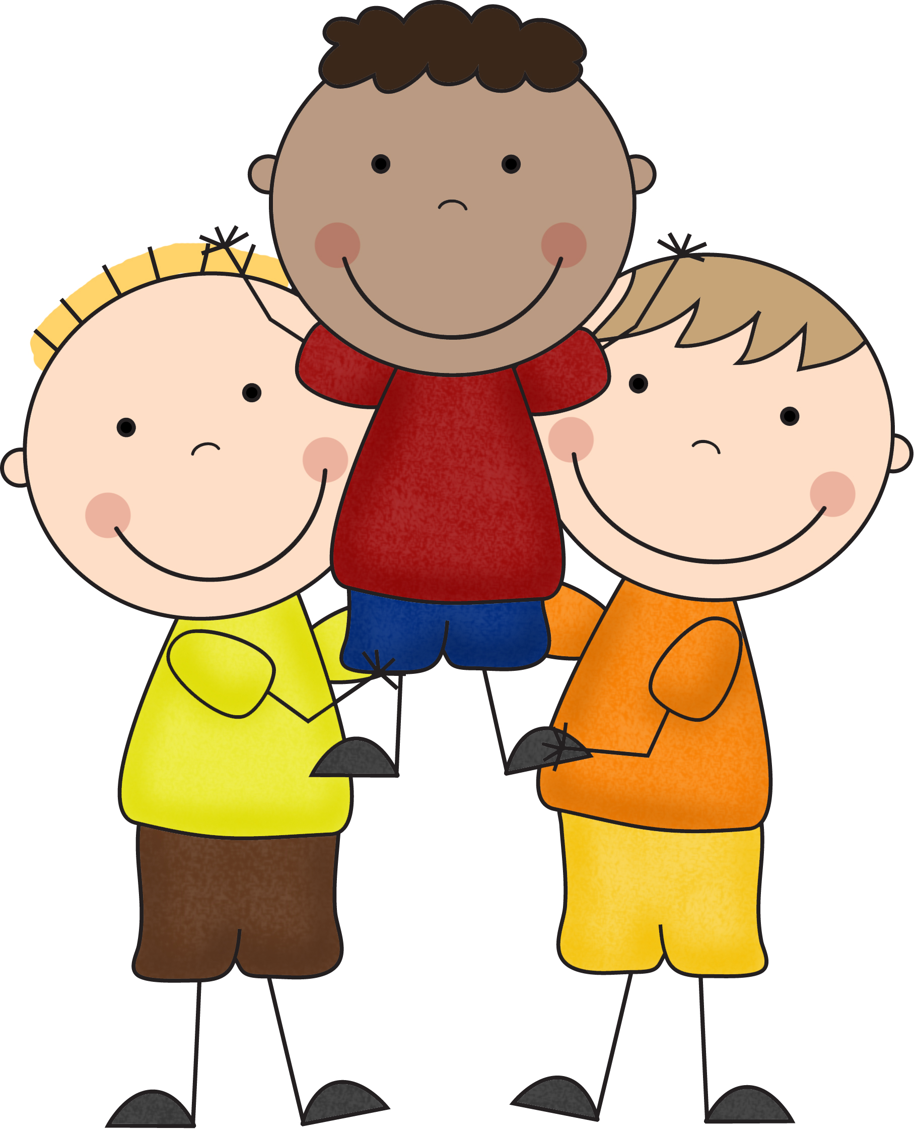
Social Studies
Working Together
Our Community of Cultures
Communities at Work
Our Changing World
Notes:
Here are the units that we will cover in social studies

Slide 10
Health
Social & Emotional
Safety, First Aid & Injury Prevention
Disease Prevention & Control
Nutrition & Fitness

Slide 11
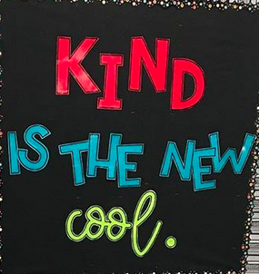
Social Emotional Learning
Notes:
WE work with the students and include them on creating the rules, how we are responsible, respectful, and ready to learn in all areas of the school. We work with the students on what it takes to be a good friend, how to include everyone, be nice, etc.

Slide 12
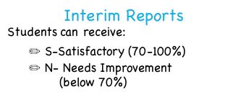
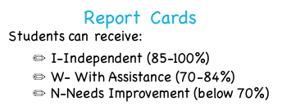
Grades
Qtr. 1- Tues. 10/8
Qtr. 2- Fri. 12/13
Qtr. 3-Fri. 3/6
Qtr. 4-Mon. 5/18
Qtr. 1- Mon. 11/11
Qtr. 2- Mon. 2/3
Qtr. 3-Tues 4/21
Qtr. 4-Mailed home
Notes:
In 1st grade the grades students earn are the letters I, W, & N on most assignments and their report cards
On Interims, there is an X in the needs improvement or Satisfactory box
Homework is graded in learning behaviors only, not in academic grades

Slide 14
Beginning this year, the learning behaviors on the interims and report cards, have been changed to the following categories.
PLEASE KEEP IN MIND: First graders are consistently working on these throughout the year!
Demonstrates Interpersonal Skills | Shows respect to peers and adults Interacts positively with peers and adults Shares opinions respectfully Contributes positively to the classroom and school community Demonstrates digital citizenship
Demonstrates Responsibility | Follows established schoolwide and classroom procedures Follows oral and written directions Exhibits self-control and manages emotions Participates actively in learning Manages time effectively to complete work Organizes and manages materials

Slide 15
Demonstrates Perseverance | Works through challenges Attempts new strategies when needed Solves problems Asks questions and seeks information Accepts and learns from feedback Demonstrates stamina
Demonstrates Collaboration | Works cooperatively in a variety of settings (e.g. whole group, small group, online, guided, and unguided) Thinks flexibly Acknowledge others’ ideas Demonstrates ability to reach compromise Shares responsibility Contributes to conversations and group discussions
Demonstrates Initiative | Takes appropriate academic risks Begins task without prompting Demonstrates self-advocacy Uses technology to demonstrate learning Selects appropriate tool(s) for the task Seeks to improve work

Slide 16
Your children have worked hard ALL day long.
We don’t want you to go through the “homework battle.”
SO, we are encouraging….
PLAY

Slide 17
Math paper/math facts (8-10 min.) M/W
Read (8-10 min.)T/Th
Homework
Notes:
There will be some homework throughout the week. We feel strongly that students need to PLAY, first and foremost. They work hard ALL DAY LONG and need to play with friends and family.

Slide 18
CLASS DOJO
What is Class Dojo?
Class Dojo helps teachers positively encourage students in class, easily communicate with parents, and empower students by promoting positive feedback.

Slide 19
Please be “Minionful”/mindful
First Graders are constantly learning!
Notes:
First year for Class Dojo
Kids don’t go out of their way to lose points
We ALL make mistakes and it’s using those mistakes to learn from and make changes to our behaviors- It take TIME and LOTS of repetition.
Stuents have usually gotten several reminders before points are lost

Slide 20
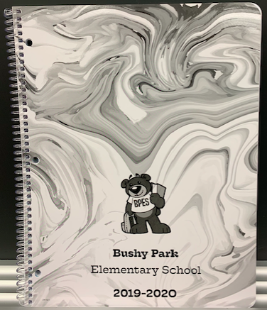
Agenda Book
Students will:
Write homework assignments in on Monday
Parents Should:
Initial Nightly
Notes:
All students will be getting an agenda book where assignments will recorded and notes can be written to teachers.

Slide 21
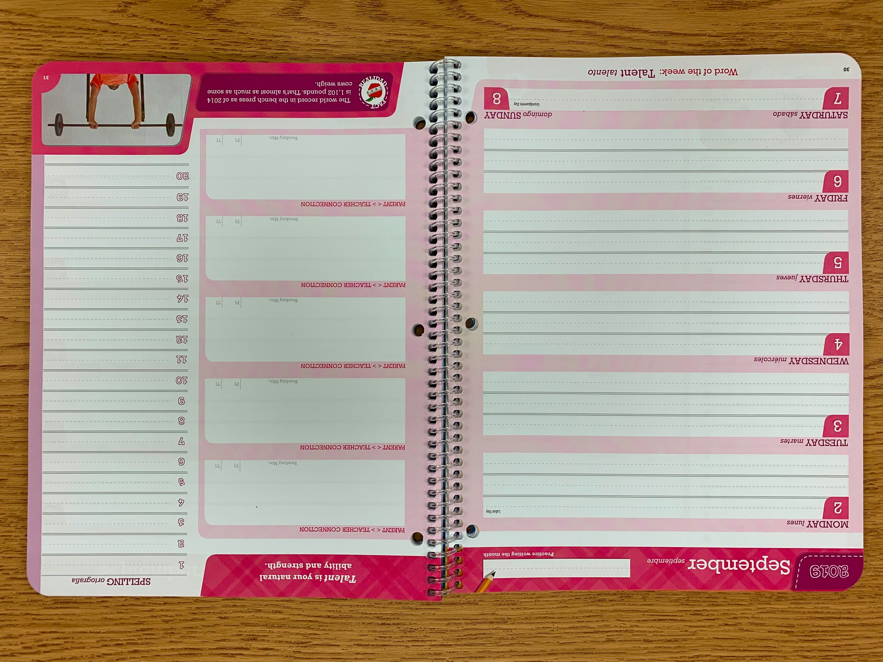
Sample Page in Agenda Book
Homework will be written here
Parents initial
here
nightly
Notes:
Share each page/section of agenda book with parents

Slide 22
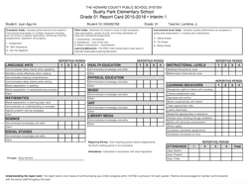
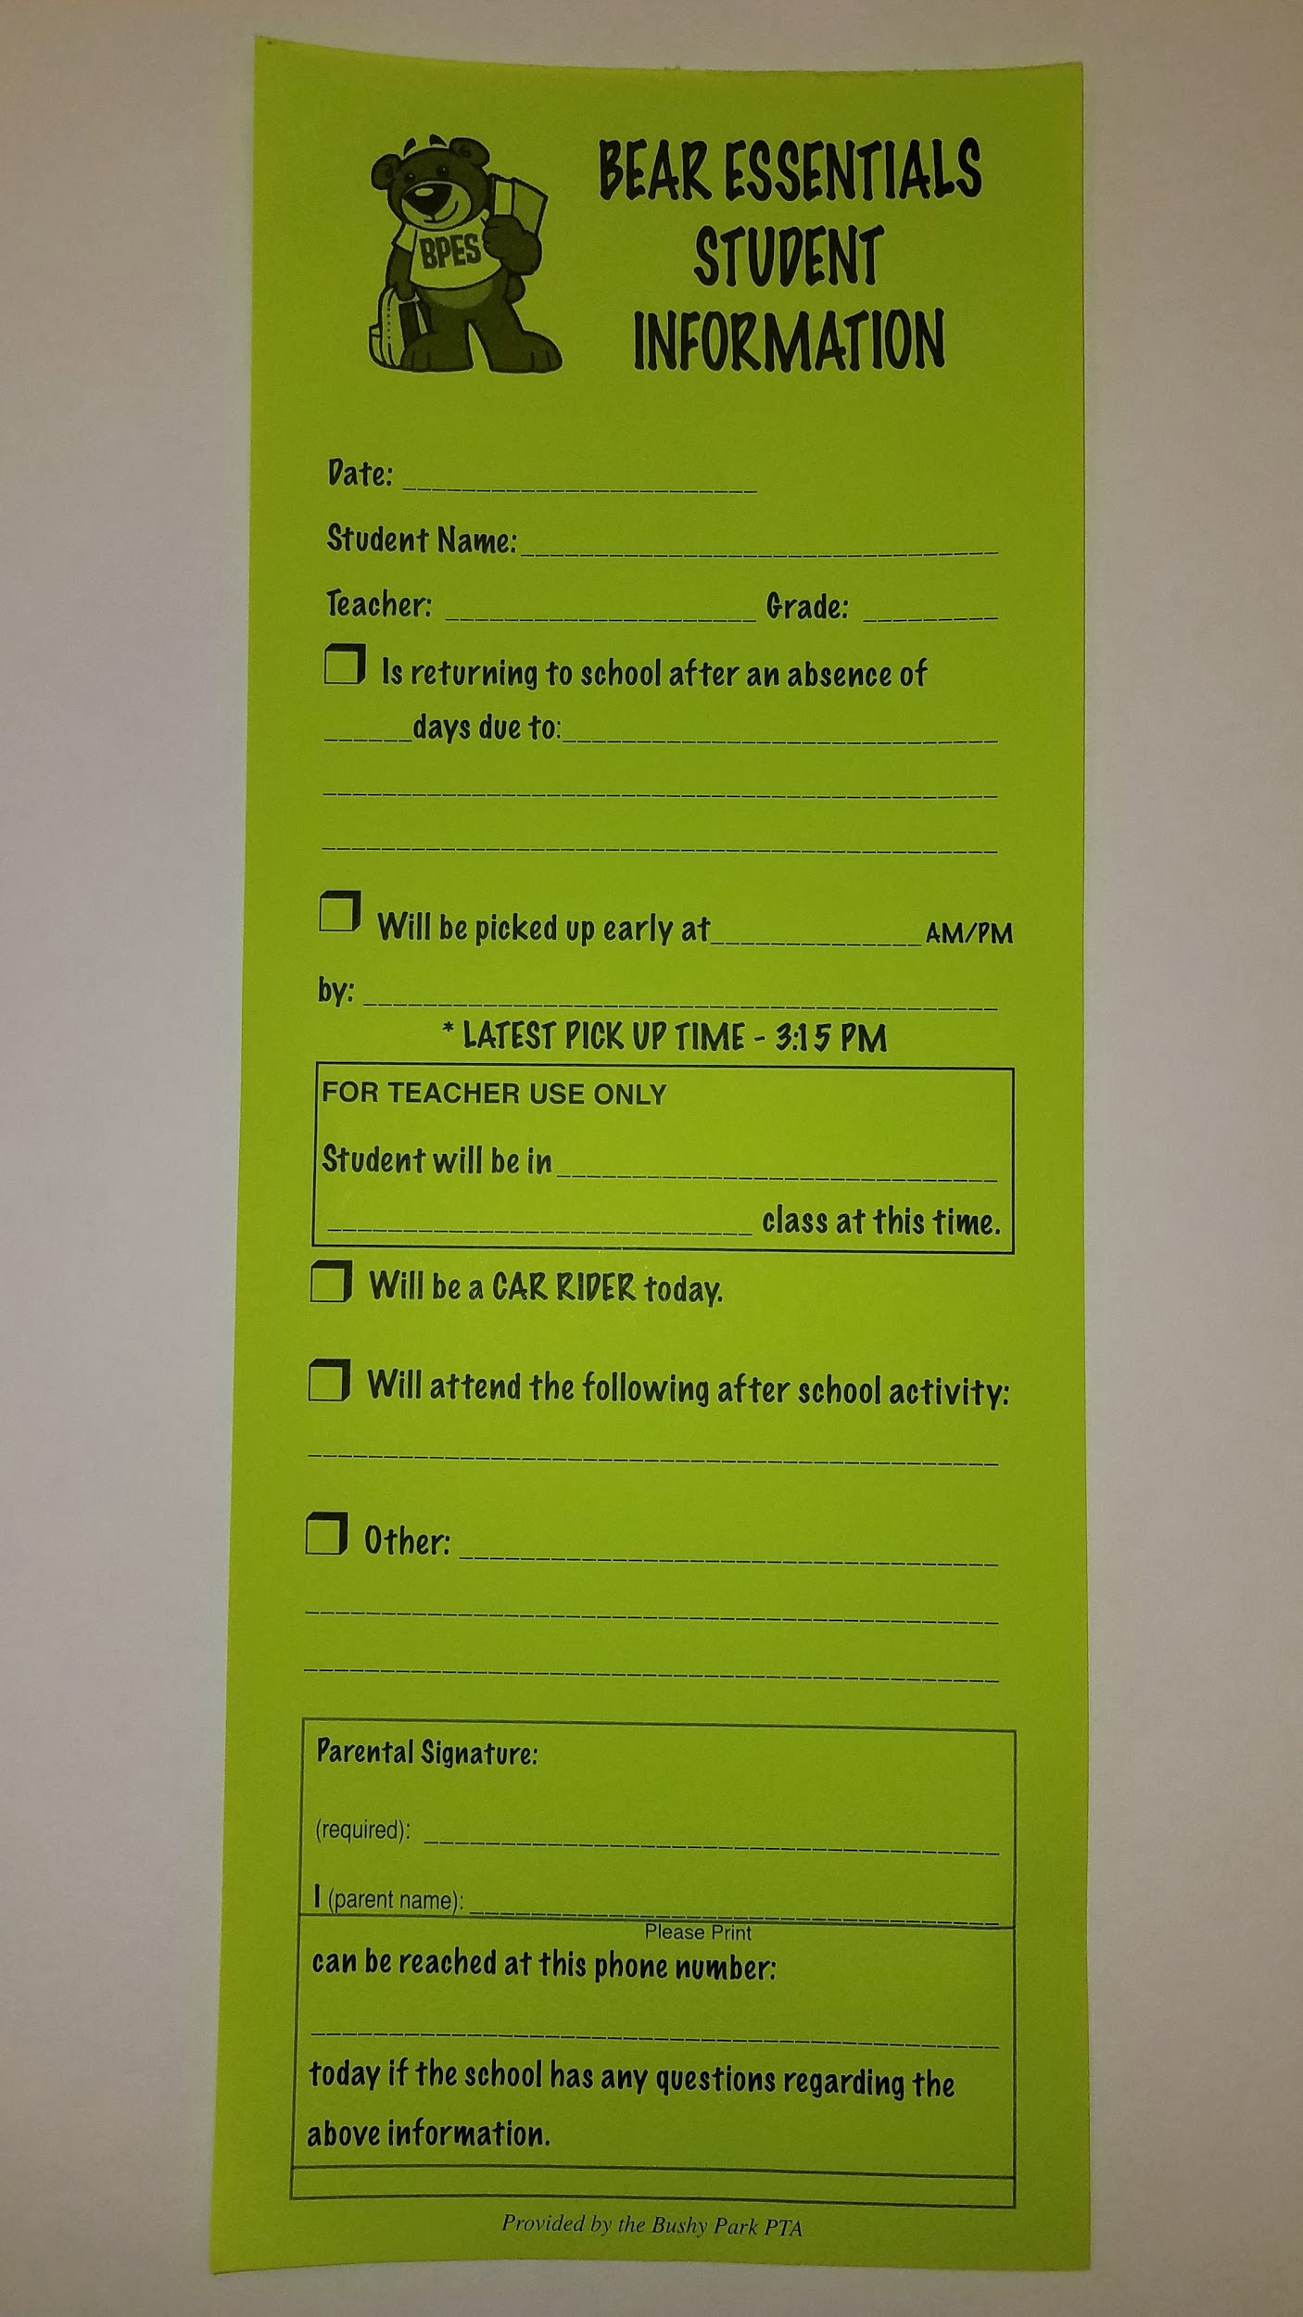
Communication
Notes
Send in yellow folder or write in agenda book
Phone calls
💻 Email - linked on the school website
📓 Interims/Report cards-quarterly
Green Notes or a piece of paper
Notes:
Show pocket in yellow folder
Phone calls can only be made in afternoon during planning time

Slide 23
All volunteers need to complete the volunteer training online (Team parent, room parent, field trip chaperone, gingerbread houses, snow day)
School website: http://bpes.hcpss.org
Follow directions for volunteer training & the Howard County training-Please print out and send in, both certificates, to school.
Training must be completed again, even if you completed it last year.
Notes:
Thank you to those who just attended the volunteer training. For those of you who couldn’t attend, you can find the online trainings on the school website.
PLEASE print out BOTH certificates and send in with one of your children so that we can document you’ve taken the trainings.

Slide 24
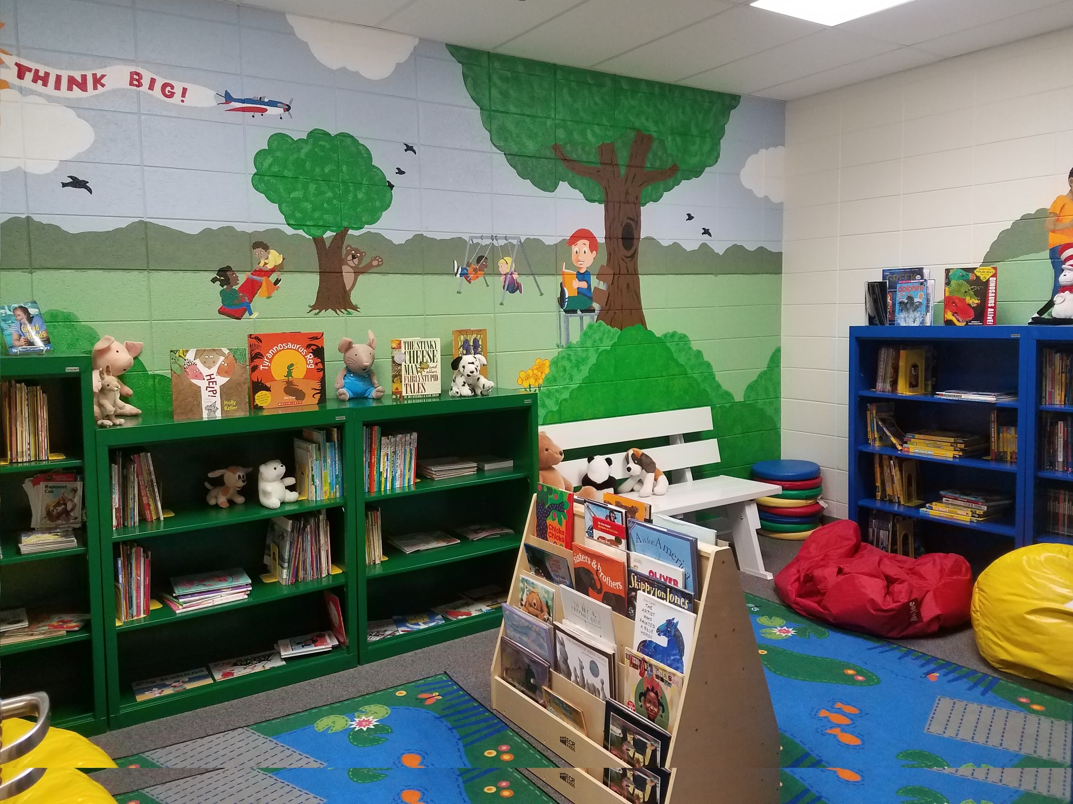
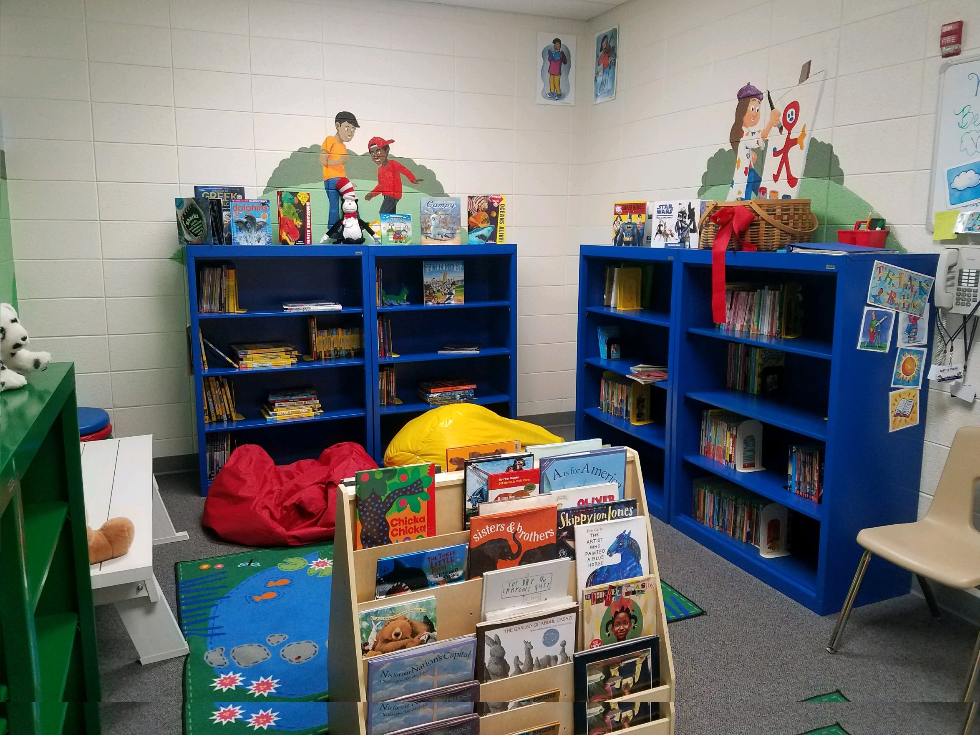
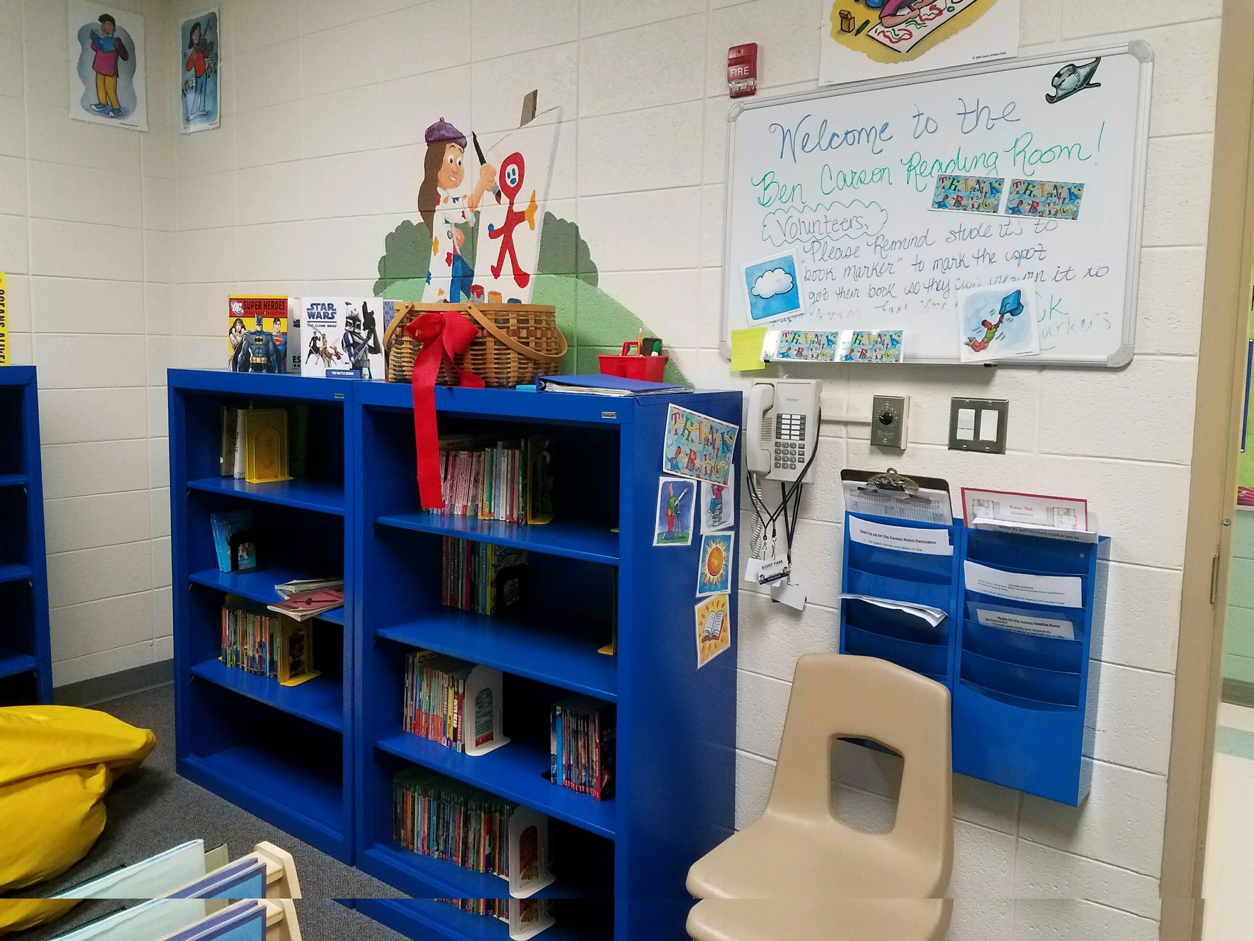
Carson Reading Room
Notes:
We need your help!!!! Please consider volunteering to take different students to the Carson Reading Room. The students LOVE going and are excited to read when they are there. Please visit the PTA web page to contact the coordinators. If you were trained last year, you don’t need to redo the Carson Reading Room training. You must be trained for volunteering in the Carson Reading Room in addition to the Volunteer training.

Slide 25
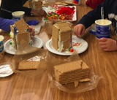
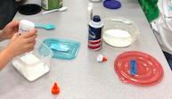
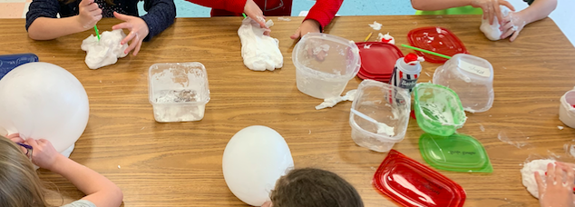
Fun in First
Gingerbread Houses
Sn⛄w Day

Slide 26
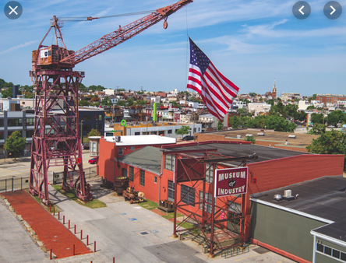
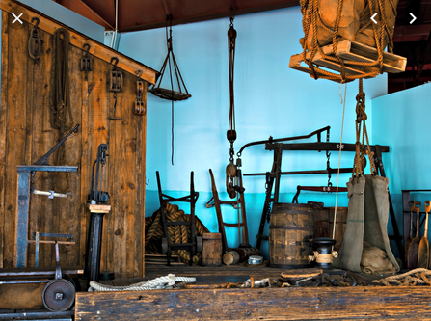
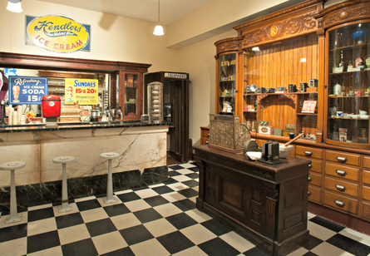
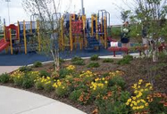
Field Trips
🚌 November - MD Science Center
1 chaperone per student
🚌 May - Baltimore Museum of Industry
4-5 chaperones per class (per museum guidelines)
🚌 June - Western Regional Park - End of year picnic
Families meet us at the park

Slide 27
Miscellaneous
🚌 Dismissal
🌟 Star of the Week sign up
📷 Photo

Slide 29
Thanks for coming...
We are looking forward to a GREAT year in first grade!
Notes:
There are sign up sheets for volunteers in the hallway outside of the cafeteria and Media center.

